Slide 1

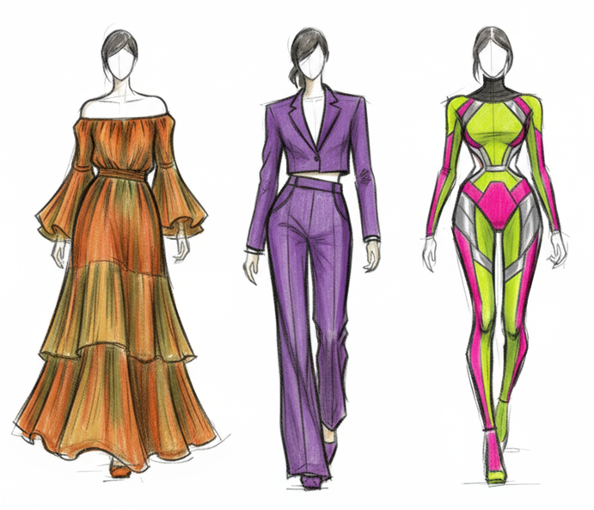
Sketch2Runway – Gen AI in Fashion
Nitin Tiwari
Google Developer Expert – Machine Learning Senior Data Scientist at Zelar

Slide 2
$whoami
Senior Data Scientist at Zelar
Google Developer Expert in Machine Learning
Contributor to Gemini, Gemma Cookbooks, TensorFlow.js, Google Dev Library
Technical Speaker (50+ talks across India and internationally)
Write blogs on AI/ML on Medium

Slide 3
Content
Introduction
AI in Fashion
Introduction to Google Gen Media
About Sketch2Runway
Project Demonstration
Resources

Slide 4
Introduction

Slide 5
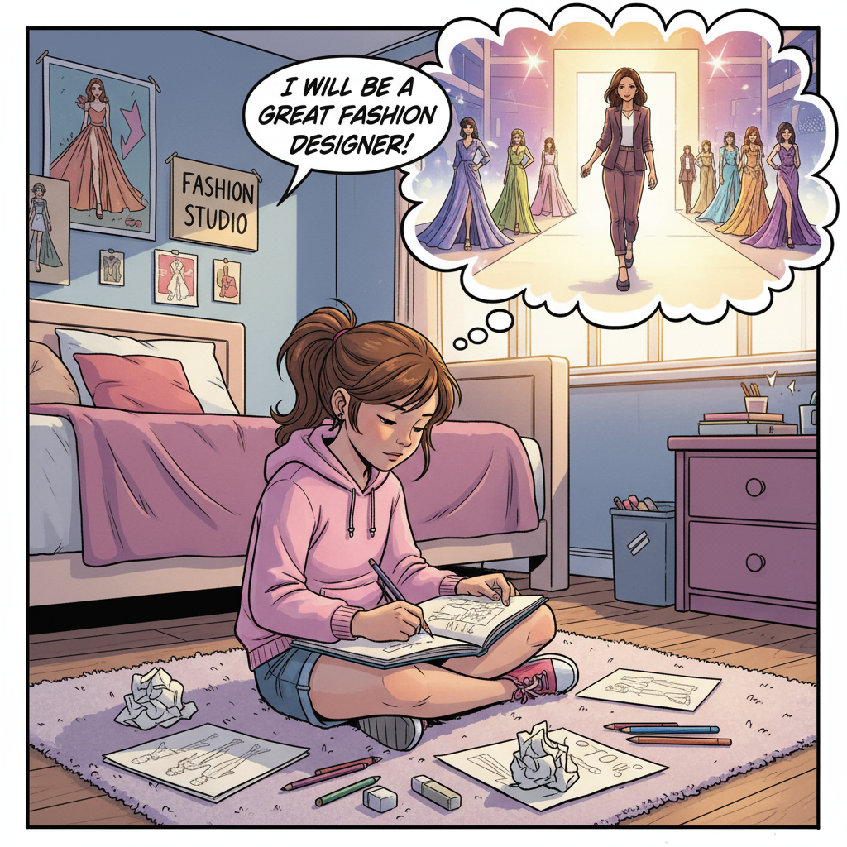
Introduction
Every expert in a field starts small – with scribbles, mistakes, and dreams.
Meet Mira. She’s not a designer yet, but she has big dreams.
She spends hours sketching in her room, imagining her creations on the runway.
But the path from sketchbook to spotlight is full of challenges like time, cost, and limited access to resources.
What if technology could help dreamers like Mira bring their fashion visions to life?
That’s where Generative AI comes in.

Slide 6
AI in Fashion

Slide 7
AI in Fashion
AI is transforming the fashion industry by personalizing customer experiences through virtual try-ons, and AI-powered stylizations.
Accelerate designs by generating new clothing concepts and enabling rapid prototyping from sketches.
AI-powered visual search helps customers find products faster by uploading images or photos.
Brands use AI for demand forecasting and inventory optimization to reduce waste and improve sustainability.

Slide 8
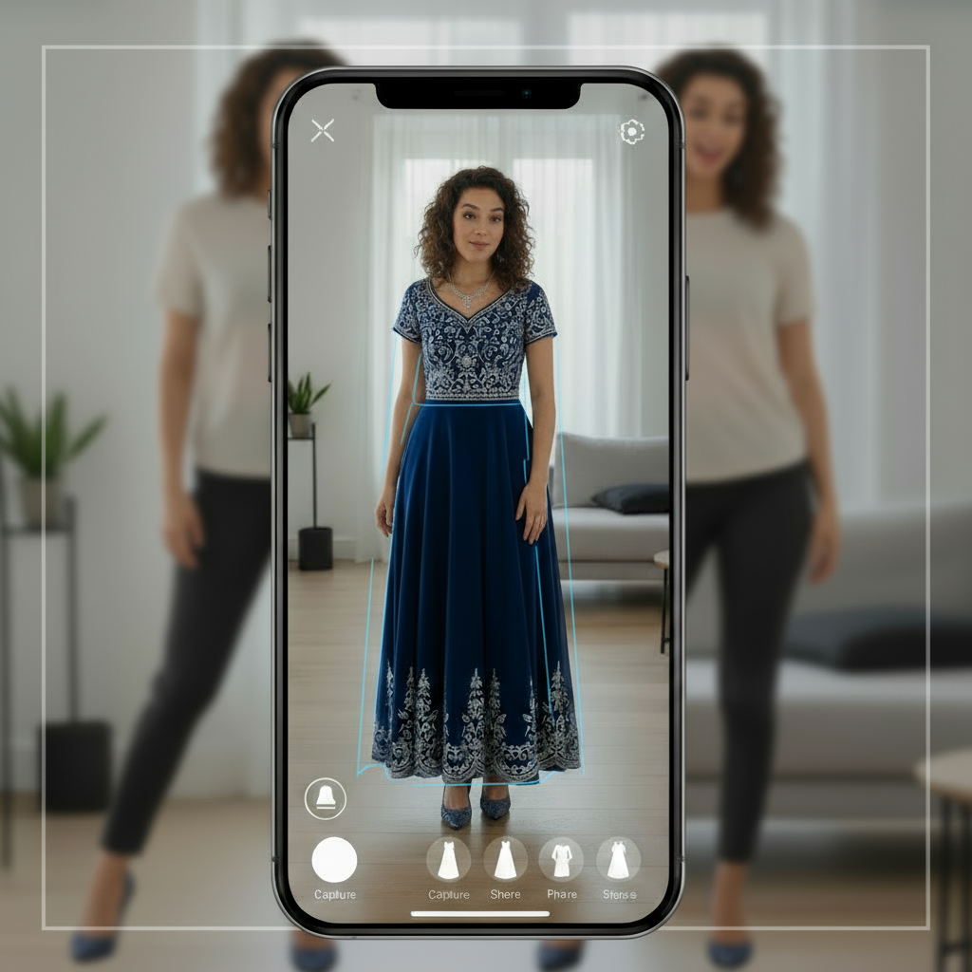
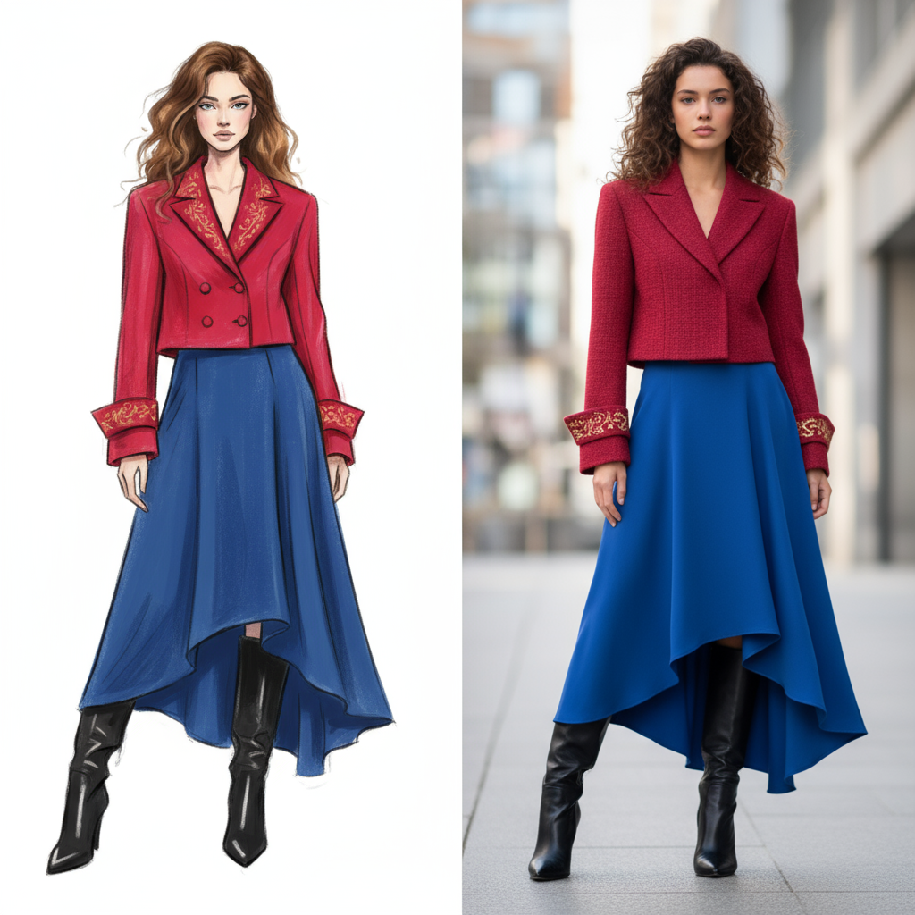
Virtual Try-On
Sketch2Design

Slide 9




Fashion Industry using AI
Generative design of sneakers
AR-powered virtual try-ons for shoes and accessories
and many more …
Analyze customer preferences and social media trends
AI for supply chain optimization and predictive analysis

Slide 10

Google Cloud Gen Media on Vertex AI

Slide 11
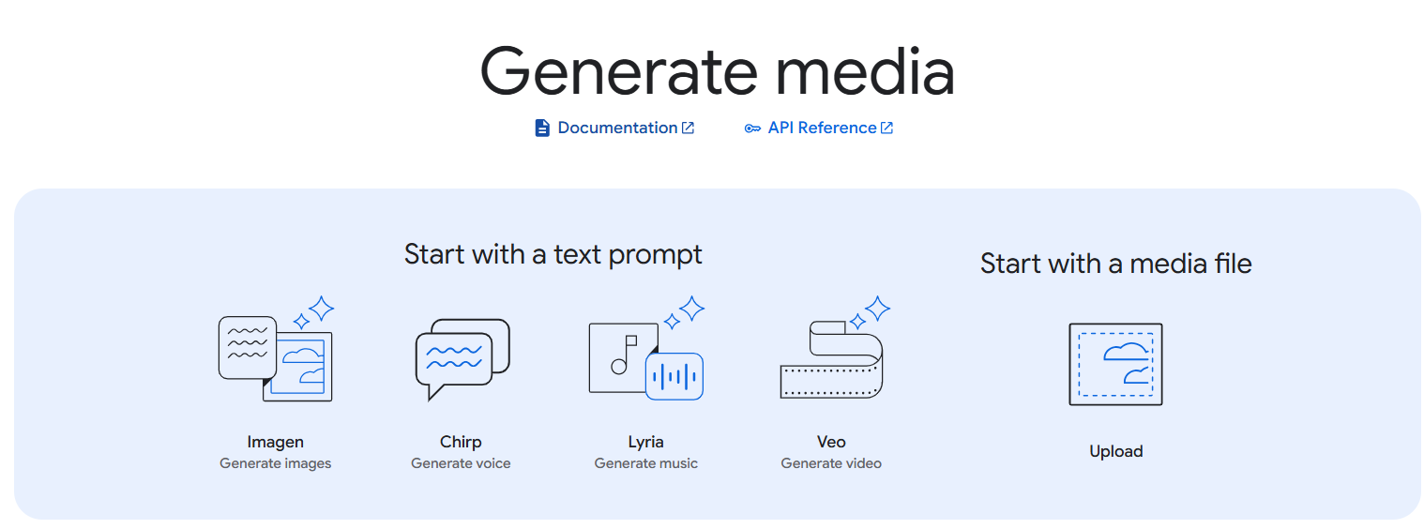
Google Cloud Gen Media
Google Cloud provides a suite of generative AI tools on Vertex AI called Gen Media, designed to help businesses create high-quality media content.
These tools use advanced AI models to generate images (Imagen), videos (Veo), music (Lyria), voice (Chirp), etc. enabling more engaging and personalized customer experiences.

Slide 12
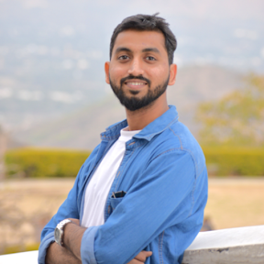

Fashion Sketch2Runway
Nitin Tiwari AI GDE
Margaret Maynard-Reid AI GDE

Slide 13
Fashion Sketch2Runway
Developed in collaboration with fellow AI GDE Margaret Maynard-Reid, Sketch2Runway is a project that showcases Google’s Generative AI models Gemini 2.5 Flash (Nano Banana 🍌) and Veo 3 for fashion design.
It converts your sketch to a beautiful fashion photo which you can edit and then turn it into a stunning 8-second video with the start-of-art video generation model Veo 3.

Slide 14
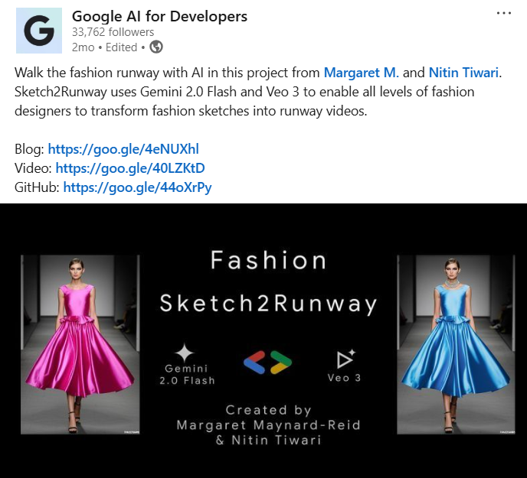
**This project was featured by the official handle of Google AI for Developers**

Slide 15
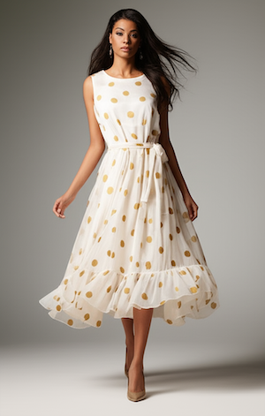
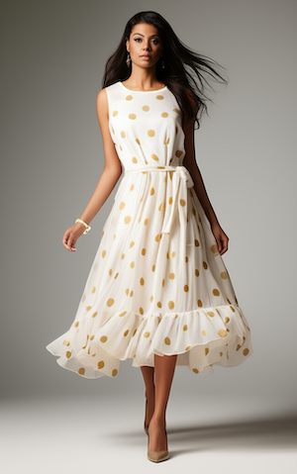
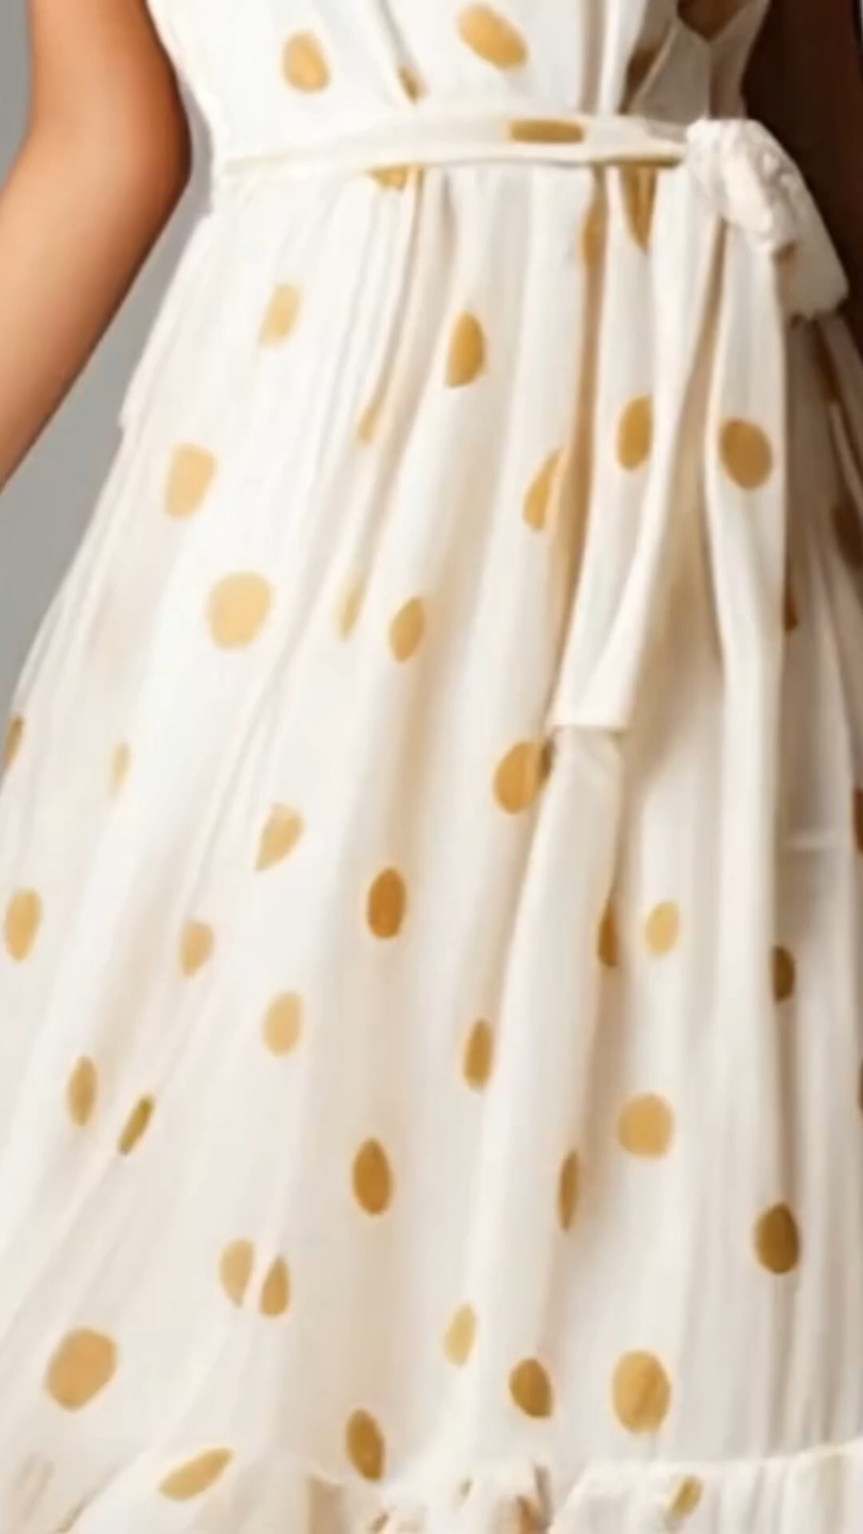
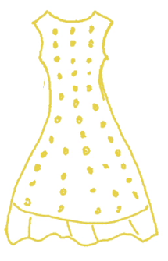
Fashion Sketch2Runway – Pipeline
Step 1: Draw Sketch
Step 2: Generate Image
Step 3: Edit Image
Step 4: Generate Video
Convert the sketch to a photorealistic full body portrait of a fashion model wearing a chic dress
Add a beautiful matching bracelet that goes well with her dress
She walks forward gracefully with a smile. Add runway music
Input
Gemini 2.5 Flash
Gemini 2.5 Flash
Veo 3

Slide 16
Project Demonstration

Slide 17
Steps to Install
Clone the repository on your local machine.
Navigate to cd sketch2runway directory.
Run pip install -r requirements.txt to install the packages.
Open .env file and configure your GEMINI_API_KEY, GCP_PROJECT_ID, GCP_BUCKET_NAME.
Run flask run to start the server.
Open localhost:5000 on your web browser to bring up the web UI.

Slide 18
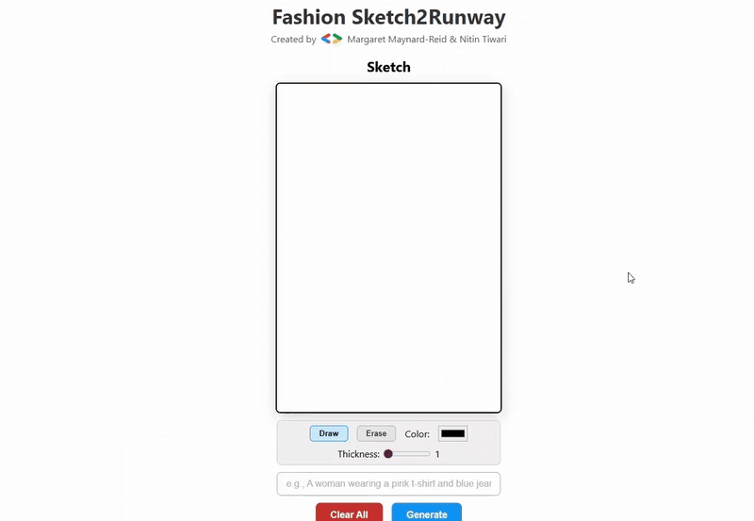
Demonstration

Slide 19
Resources

Slide 20
Resources
GitHub repository: https://github.com/margaretmz/sketch2runway
Colab notebook: https://github.com/margaretmz/sketch2runway/blob/main/Sketch2Runway.ipynb
YouTube Tutorial: https://www.youtube.com/watch?v=9Bo5sEVoVQk
Medium blog: https://medium.com/google-developer-experts/fashion-sketch2runway-with-gemini2flash-veo3-ced1e2776fea
Gemini API documentation: https://ai.google.dev/gemini-api/docs
Vertex AI Studio: https://console.cloud.google.com/vertex-ai/studio/

Slide 21


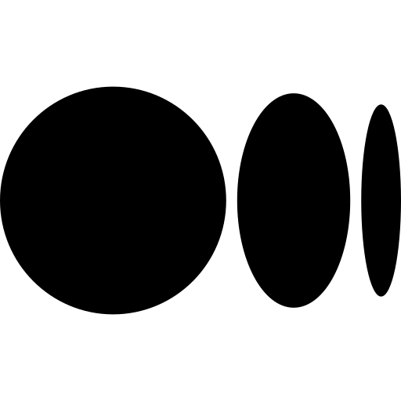


Thank You.
linkedin.com/in/tiwari-nitin
medium.com/@tiwarinitin1999
twitter.com/@NSTiwari21
github.com/NSTiwari

